Slide 1

Employee Attrition
Analysis

Slide 2
Employee Attrition
What is Employee Attrition?
Employee attrition, which refers to the rate at which employees leave an organization, is a significant concern for companies as it can have far-reaching consequences on productivity, morale, and overall organizational performance.
Effects of high employee attrition:
Loss of institutional knowledge and experience
Increased recruitment and training costs
Decreased productivity and efficiency
Lower employee morale and engagement
Disruption of team dynamics and continuity

Slide 3
Problem Statement
XYZ company which was established a few years back is facing around a 15% attrition rate for a couple of years. And it's majorly affecting the company in many aspects. In order to understand why employees are leaving the company and reduce the attrition rate XYZ company has approached an HR analytics consultancy for analyzing the data they have. You are playing the HR analyst role in this project and building a dashboard which can help the organization in making data-driven decisions.

Slide 4
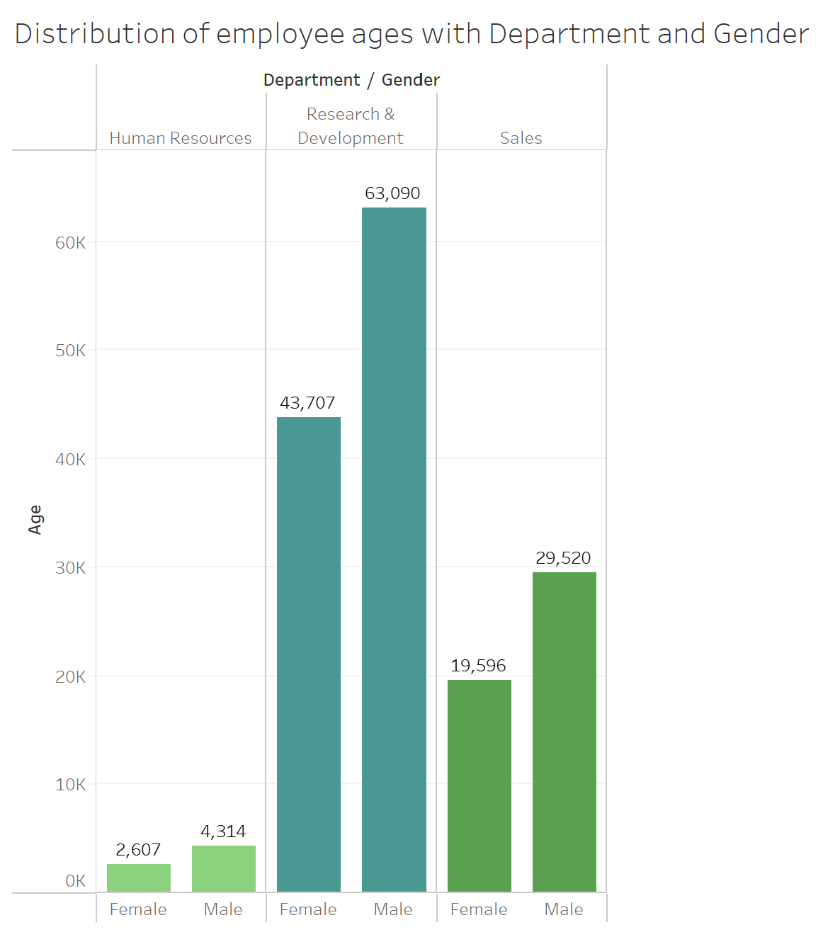
Distribution of Employees ages with department and Gender
The gender composition varies significantly between departments. Research & Development and Human Resources have a predominantly female workforce, while Sales appears more balanced in terms of gender representation.
There are noticeable differences in the age distribution across departments. Research & Development seems to have a younger employee base concentrated in the 30s and 40s age groups, whereas Sales has a more diverse age range spanning from the 20s to the 50s.

Slide 5
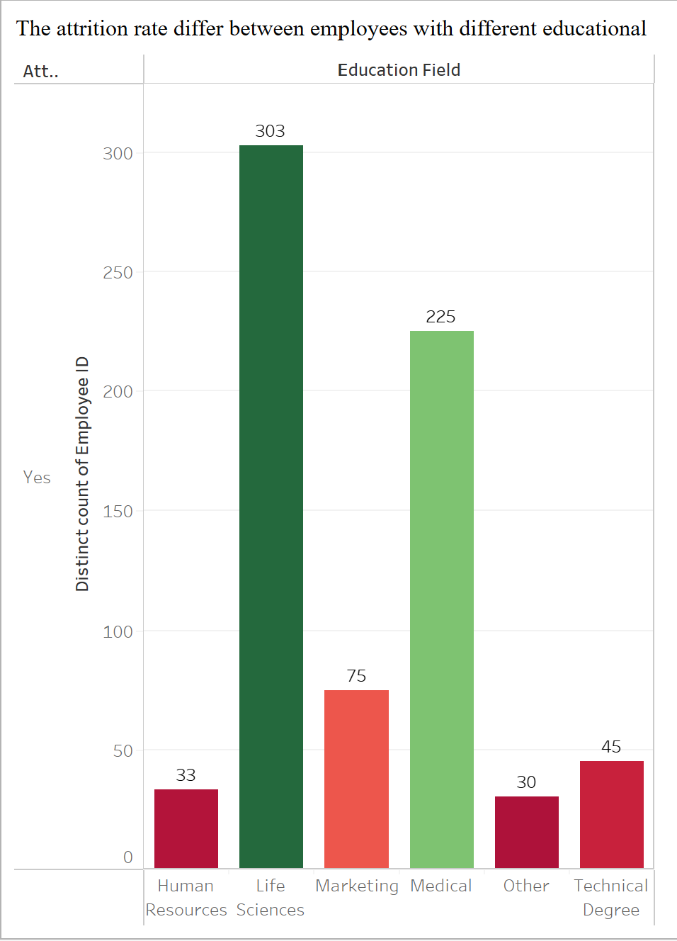
The attrition rate differ between employees with different educational background
Employees with Life Sciences degrees leave the company the most, with 303 cases, much higher than other fields. This suggests the need to explore why these employees are leaving, such as job satisfaction or career growth issues.
Employees with Human Resources and Medical degrees leave the company less often, indicating they might be more satisfied or better suited to their roles. Studying their retention strategies could help improve employee engagement and reduce turnover in the company.

Slide 6
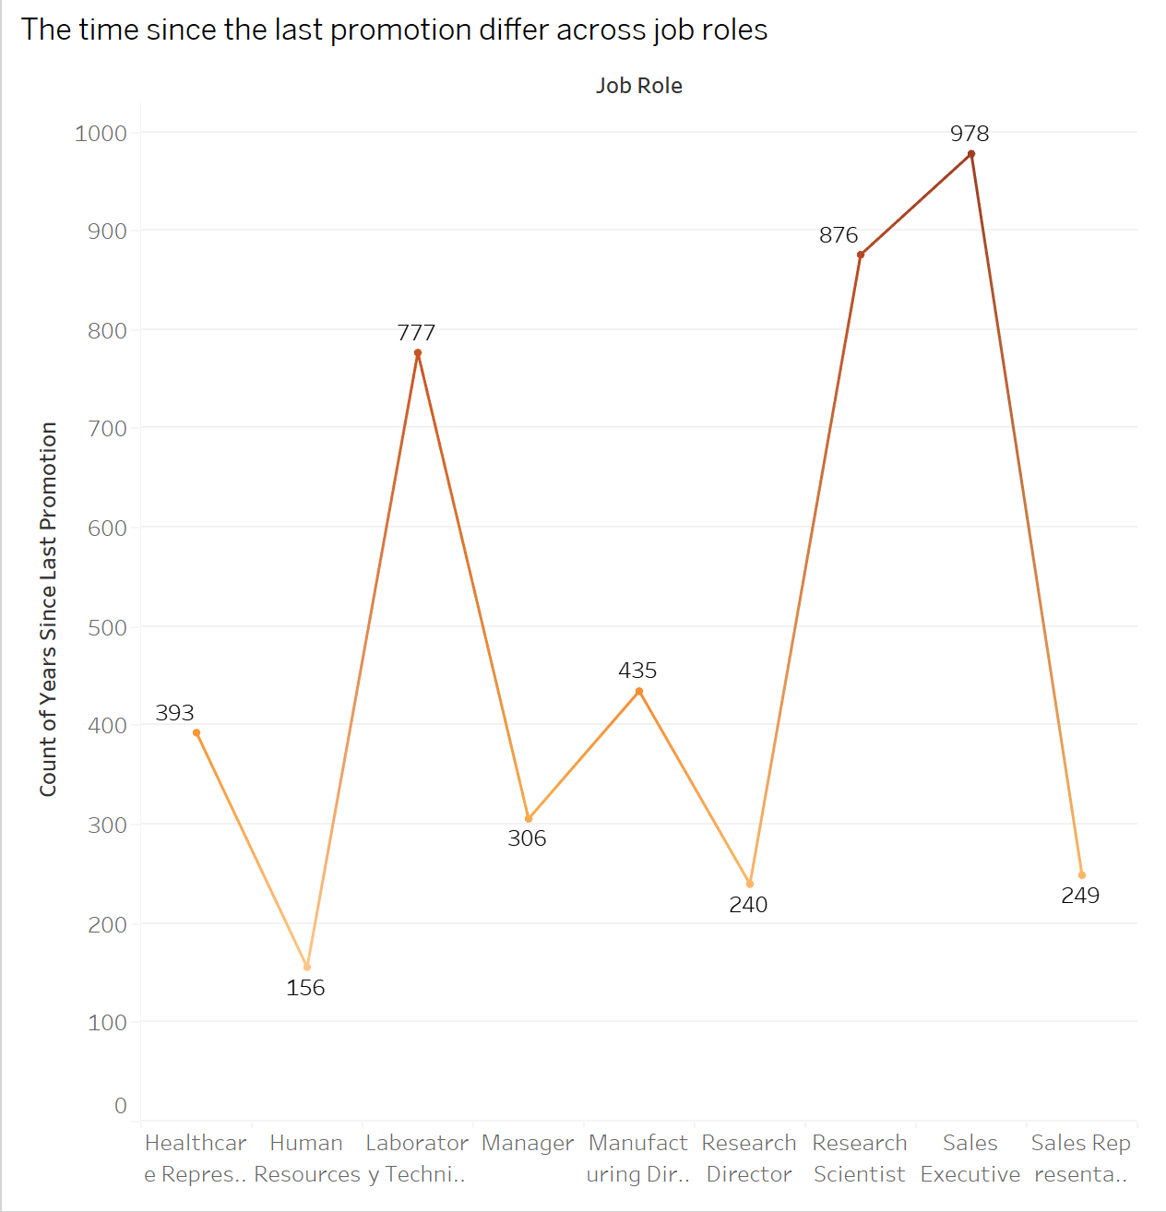
The time since the last promotion differ across job roles
Sales Representatives and Sales Executives have gone the longest without a promotion, with times of 978 and 876 days. This might indicate issues with career growth for sales staff that need to be looked into.
Healthcare Representatives get promoted the fastest, with an average of 156 days since their last promotion. This could be due to good career planning and clear advancement opportunities in the healthcare department.

Slide 7
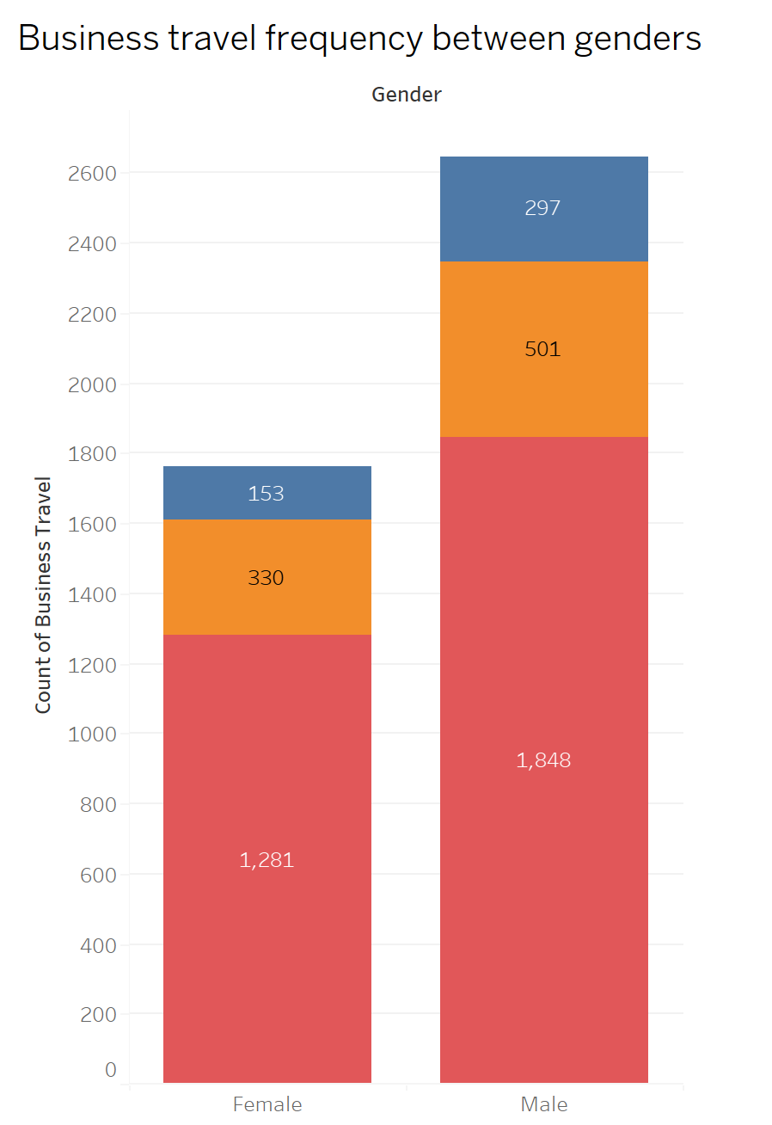
Business travel frequency between Genders
Male employees travel for business much more often than female employees at all levels, shown by taller bars for males.
The difference in business travel between males and females is small at the lowest level (153 vs. 330), but it grows bigger at higher levels, with males traveling almost twice as much at the top level

Slide 8
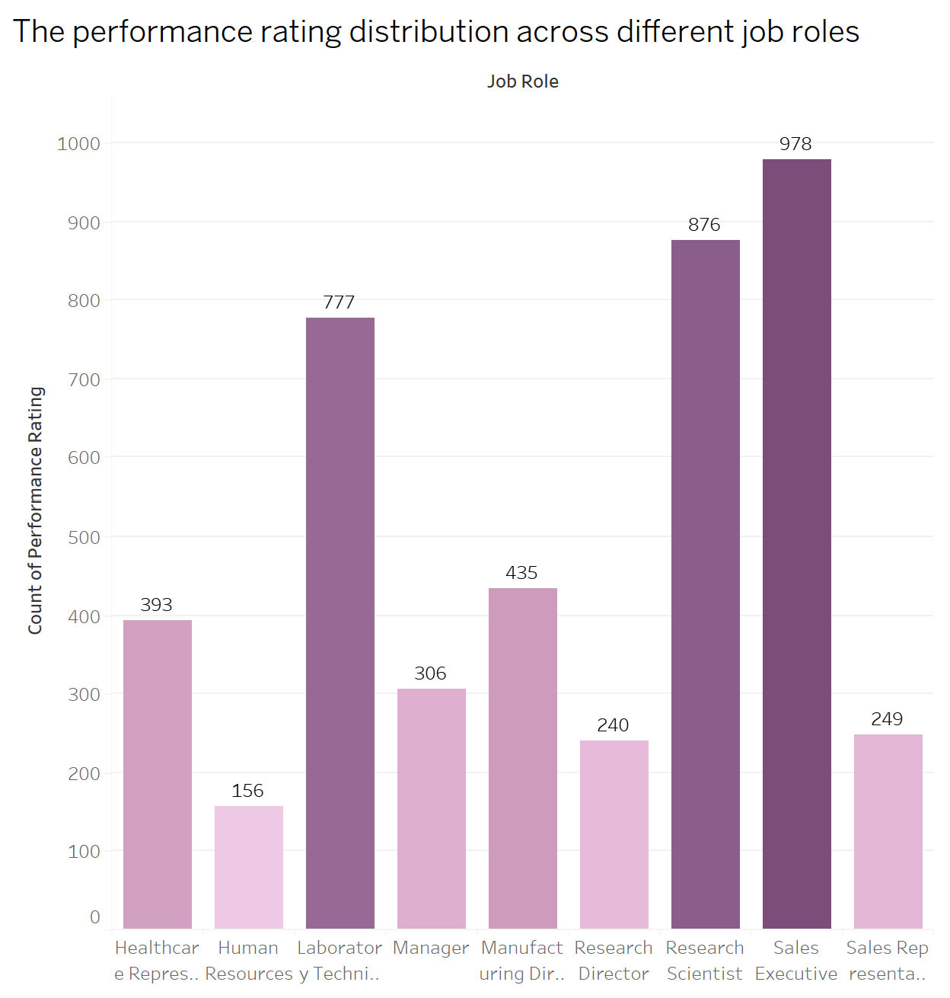
The performance rating distribution across different job roles
Sales Representatives and Sales Executives get the highest performance ratings, shown by the tallest bars. This might mean the sales department has good performance management and incentives.
Human Resources and Healthcare Representatives get the lowest performance ratings, shown by the shortest bars. This might mean there are issues with job design, training, or evaluation criteria in these roles that need to be looked into.

Slide 9
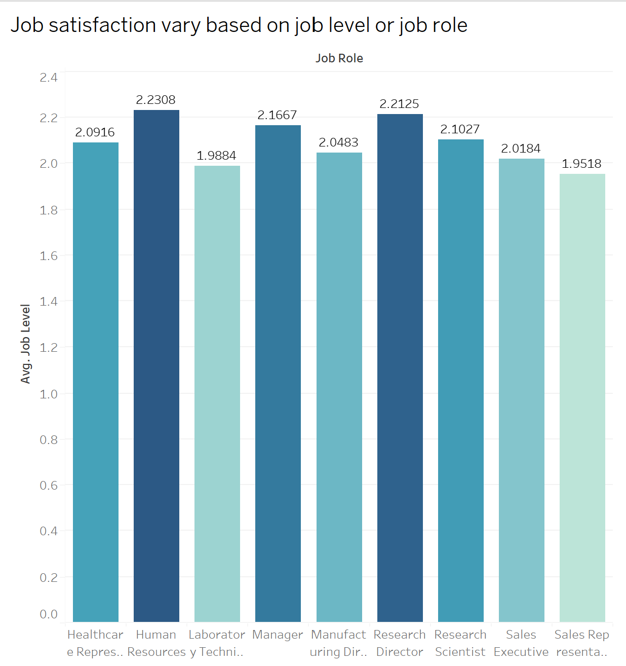
Job Satisfaction vary based on job level or job roles
The graph shows that job satisfaction levels vary across different job roles, with Human Resources having the highest average job satisfaction level of 2.2308 and Sales Representatives having the lowest at 1.9518.
There is a general trend where higher-level roles like Research Director and Sales Executive tend to have higher job satisfaction compared to more entry-level roles like Sales Representatives and Laboratory Technicians.

Slide 10
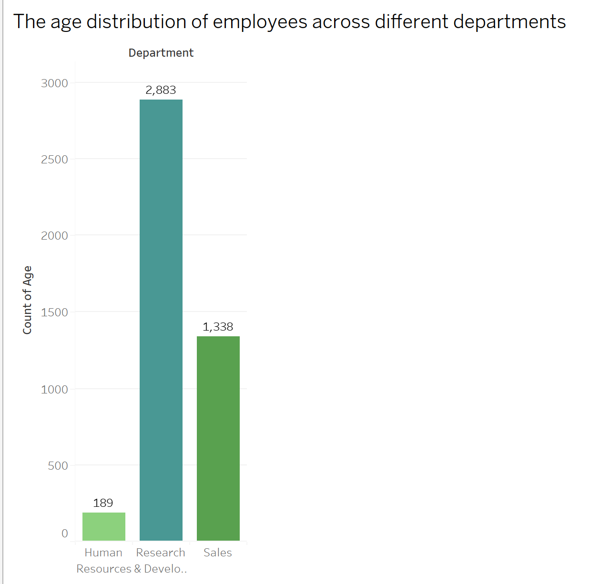
The age distribution of employees across different departements
The Research department has the largest number of employees, with 2,883 individuals, significantly more than the Sales department (1,338 employees) and the Human Resources & Development department (189 employees).
The Human Resources & Development department has the smallest workforce among the three departments shown in the graph.

Slide 11
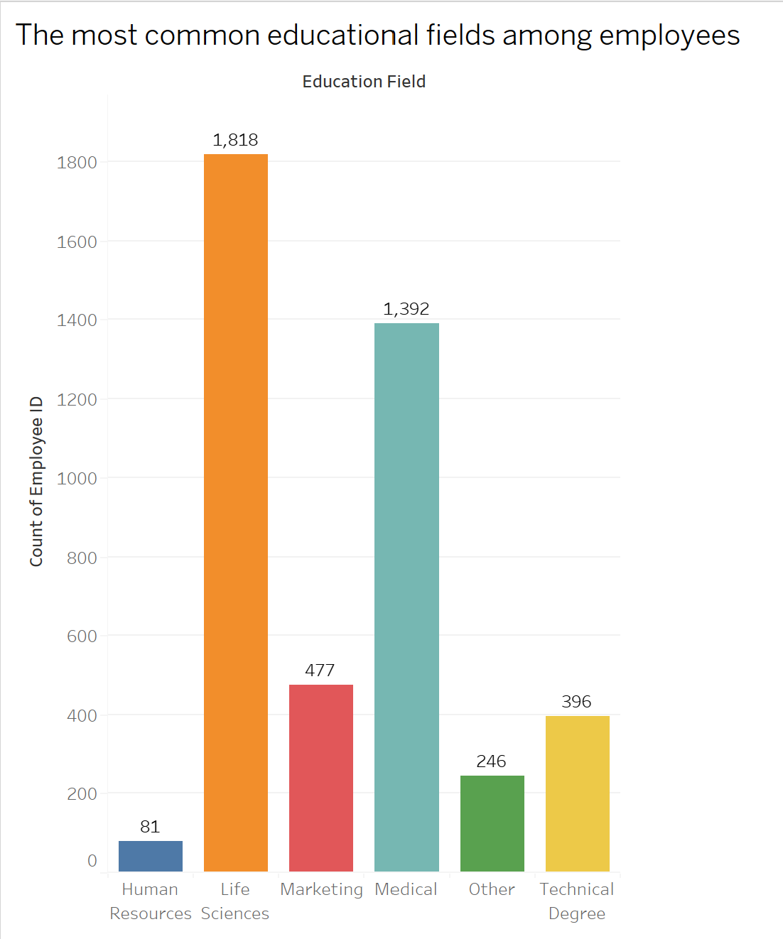
The most common educational fields among employees
Life Sciences is the most common educational field among employees, with 1,818 individuals holding degrees in this area.
Human Resources and Other educational fields have the lowest representation, with 81 and 246 employees respectively.

Slide 12
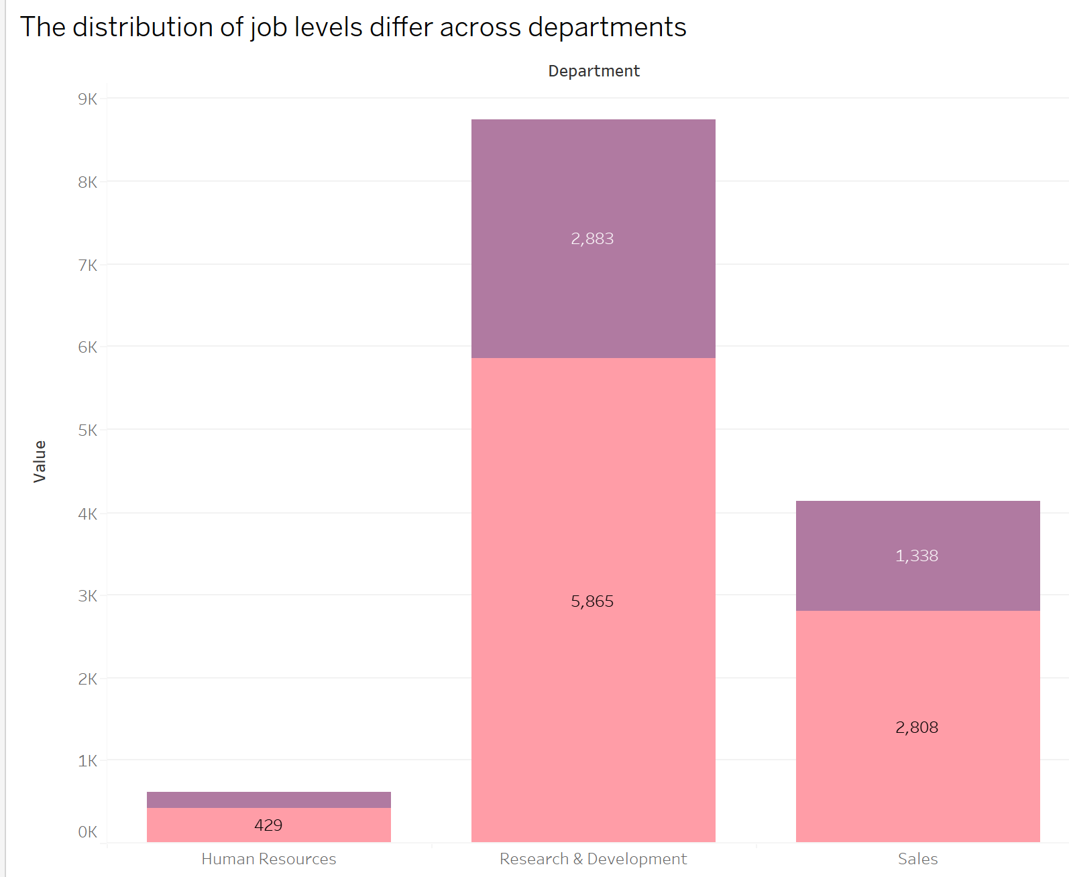
The distribution of job levels differ across departments
The Research & Development department has the largest number of employees across different job levels, with 2,883 employees in higher job levels and 5,865 employees in lower job levels.
The Human Resources department has the smallest workforce, with only 429 employees in lower job levels and no employees shown in higher job levels.

Slide 13
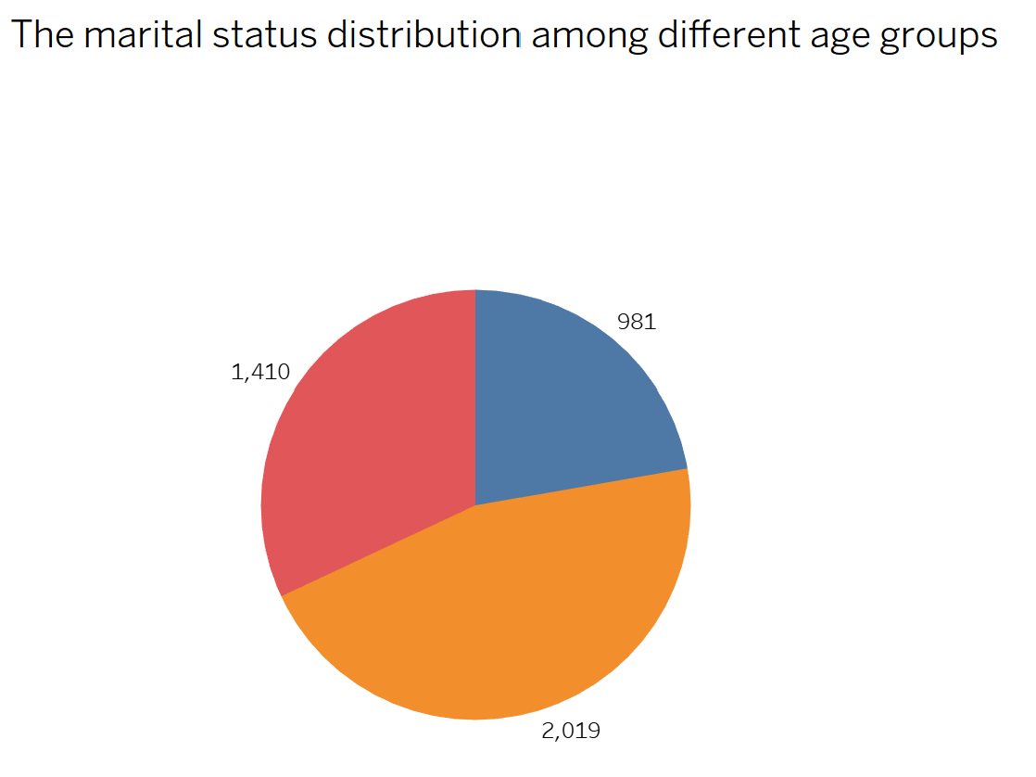
The marital status distribution among different age groups
The largest portion of the pie chart represents single individuals, with 2,019 employees falling into this marital status category across different age groups.
The smallest portion represents divorced employees, with 981 individuals in this marital status across the various age groups shown.

Slide 14
Conclusion
Gender and Age Balance: There's a gender imbalance in departments like Human Resources and R&D, which are mostly female, while Sales is more balanced. R&D has younger employees, while Sales has a wide age range. Improving gender diversity and age inclusion can help create a fairer workplace.
High Turnover in Life Sciences: Employees with Life Sciences degrees leave the company the most. Looking into why they leave and making improvements in job satisfaction and career growth can help keep these employees.
Promotion Issues in Sales: Sales staff wait the longest for promotions, while Healthcare staff get promoted quickly. Improving promotion opportunities for sales staff can boost their job satisfaction.
Travel Disparities: Male employees travel for business much more than female employees, especially at higher levels. Ensuring equal travel opportunities can promote fairness.
Performance and Satisfaction: Sales staff get the highest performance ratings, while Human Resources and Healthcare staff get the lowest. Job satisfaction is highest in Human Resources and lowest in Sales. Improving job design, training, and evaluation can help boost performance and satisfaction.

Slide 15
Improvements Needed
Diversity and Inclusion: Attract and retain a diverse workforce, focusing on gender and age diversity.
Career Growth: Enhance career growth and promotion opportunities, especially for sales staff and those with Life Sciences degrees.
Fair Travel Policies: Ensure equal business travel opportunities for all employees.
Better Performance Management: Improve job design, training, and evaluation for Human Resources and Healthcare roles.
Engagement Programs: Create programs tailored to the needs of each department to boost employee engagement and motivation.

Slide 16
Thank You

